Slide 1
ITT565 Chapter 4 Domain Name System (DNS)

Slide 2
Domain Name System (DNS)
When you open your web browser and type in hub.tutsplus.com to find something interesting to learn, your computer can find a server with the IP address 190.93.242.181.
Among other technologies, a protocol called DNS helps your computer in finding that server.
https://computers.tutsplus.com/tutorials/how-to-change-your-dns-for-safer-faster-browsing--mac-61232

Slide 3
DNS: A Definition and Example
apt-get install dnsutils
DNS stands for Domain Name System and is a protocol, or language, that computers use when talking to each other.
Every device on the public Internet has an IP address;
DNS is like a phonebook that associates a domain name, hub.tutsplus.com for instance, with the server’s IP address, 190.93.242.181.
https://computers.tutsplus.com/tutorials/how-to-change-your-dns-for-safer-faster-browsing--mac-61232

Slide 4
DNS concepts:
3 types of DNS servers—DNS Resolver, DNS Root Server, and Authoritative Name Server
3 types of DNS queries—recursive, iterative, and non-recursive
10 types of common DNS records—including A (host address), AAAA (pronouns as Quad A is IPv6 host address), CNAME (Canonical name for an alias), MX (Mail eXchange), and NS (Name Server)
https://ns1.com/resources/dns-types-records-servers-and-queries

Slide 5
DNS Resolver
A DNS resolver, also called a recursive resolver, is a server designed to receive DNS queries from web browsers and other applications.
The resolver receives a hostname - for example, www.example.com - and is responsible for tracking down the IP address for that hostname.
A component called a DNS Resolver is responsible for checking if the hostname is available in local cache, and if not, contacts a series of DNS Name Servers, until eventually it receives the IP of the service the user is trying to reach, and returns it to the browser or application.
nslookup is a command-line tool that lets you test and troubleshoot Domain Name System (DNS) resolution.
To start nslookup, open a command prompt and enter nslookup
** Domain resolution is the process of converting domain names to IP addresses.
The resolution of the domain name is done by the DNS server
. Domain resolution is also called domain pointing, server settings, domain configuration, reverse IP registration, and so on.

Slide 6
DNS Root Server
Root servers, or DNS root servers, are name servers that are responsible for the functionality of the DNS as well as the entire Internet.
They're the first step in the name resolution of any domain name, meaning they translate domain names into IP addresses
A root name server is a name server for the root zone of the Domain Name System of the Internet.
It directly answers requests for records in the root zone and answers other requests by returning a list of the authoritative name servers for the appropriate top-level domain (TLD)

Slide 7
Authoritative Name Server
An authoritative name server is a name server that gives answers in response to questions asked about names in a zone.
An authoritative-only name server returns answers only to queries about domain names that have been specifically configured by the administrator.
The authoritative nameserver is typically the DNS provider or the DNS registrar (like GoDaddy which offers both DNS registration and hosting).
And here we can find the DNS record that maps example.com to the IP address 127.66

Slide 8
apt-get install dnsutils
How DNS works:
Connect to a wireless network; the router tells your computer what DNS server to use, usually the router itself.
Type hub.tutsplus.com into the web browser; the computer asks the router for the IP address for hub.tutsplus.com so it can connect to the server.
The router asks a DNS server for the IP address. If other devices have previously requested the Tuts+ Hub, the router may have the result cached already and may skip this step.
The router receives a reply from a public DNS server and sends that on to your computer; among other details, it includes an IP address such as 190.93.242.181.
The computer initiates a connection to that IP address and continues with loading the page. If the page needs resources from another domain, as many do, the computer will go through the whole process again for each domain or subdomain.
Frankly, it’s amazing that this whole process, called the resolution, takes less than a second. In fact, DNS requests can take as little as 40 milliseconds! YSlow, DNS lookups on average take between 20-120 milliseconds to complete.
https://computers.tutsplus.com/tutorials/how-to-change-your-dns-for-safer-faster-browsing--mac-61232

Slide 9
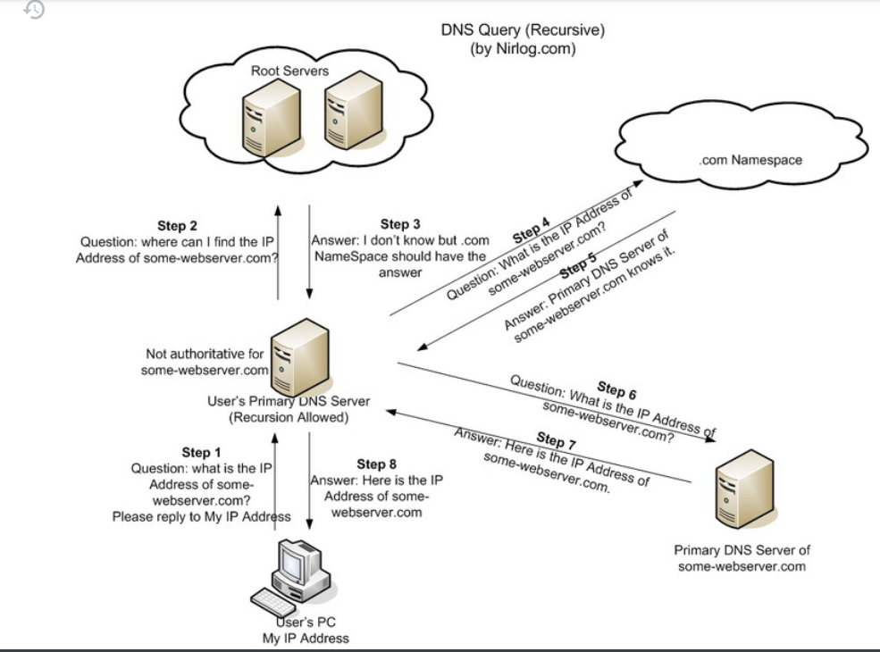

Slide 10
apt-get install dnsutils
Public DNS Servers
Your home router is likely set by default to use your ISP’s DNS servers, which may or may not be very reliable.
There are a number of third-party DNS servers available as well.
OpenDNS (208.67.220.220 and 208.67.222.222)
OpenDNS is an American company providing Domain Name System (DNS) resolution services—with features such as phishing protection, optional content filtering, and DNS lookup in its DNS servers—and a cloud computing security product suite, Umbrella, designed to protect enterprise customers from malware, botnets, phishing, and targeted online attacks.
Google Public DNS (8.8.8.8 and 8.8.4.4).
Google Public DNS is a Domain Name System service offered to Internet users worldwide by Google. It functions as a recursive name server. Google Public DNS was announced on 3 December 2009, in an effort described as "making the web faster and more secure". As of 2018, it is the largest public DNS service in the world, handling over a trillion queries per day.
Every major DNS service has at least primary and secondary servers to ensure that requests will always be answered. When changing DNS server settings, you’ll want to make sure that you specify at least two servers, although you can include more if you want.

Slide 11
More about DNS
IP assigns 32-bit addresses to hosts (interfaces)
Binary addresses easy for computers to manage
All applications use IP addresses through the TCP/IP protocol software
Difficult for humans to remember:
% telnet 134.82.11.70
The Domain Name System (DNS) provides translation between symbolic names and IP addresses
DNS runs over UDP and uses port 53 of messages less than 512 bytes; otherwise, it uses TCP port 53

Slide 12
Structure of DNS names
Each name consists of a sequence of alphanumeric components separated by periods
Examples:
www.eg.bucknell.edu
www.netbook.cs.purdue.edu
charcoal.eg.bucknell.edu
Names are hierarchical, with most-significant component on the right
Left-most component is computer name

Slide 13
Structure of DNS names
Top level domains (right-most components; also known as TLDs) defined by global authority
com Commercial organization
edu Educational institution
gov Government organization
mil Military organization
Organizations apply for names in a top-level domain:
kfupm.edu
macdonalds.com
Organizations determine own internal structure
ccse.kfupm.edu
cs.purdue.edu
*TDL – Top domain level

Slide 14
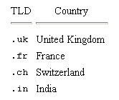
Geographic structure
Top-level domains are US-centric
Geographic TLDs used for organizations in other countries:
Countries define their own internal hierarchy: ac.uk and .edu.au are used for academic organizations in the United Kingdom and Australia. In SA, it is edu.sa.

Slide 15
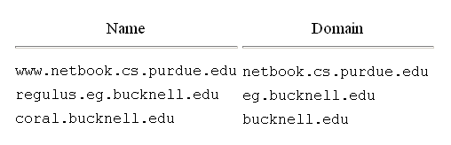
Domain names within an organization
Organizations can create any internal DNS hierarchy
Uniqueness of TLD and organization name guarantee uniqueness of any internal name (much like file names in your directories)
All but the left-most component of a domain name is called the domain for that name:
Authority for creating new subdomains is delegated to each domain
Administrator of kfupm.edu has authority to create eg.kfupm.edu and need not contact any central naming authority
DNS domains are logical concepts and need not correspond to physical location of organizations
DNS domain for an organization can span multiple networks

Slide 16
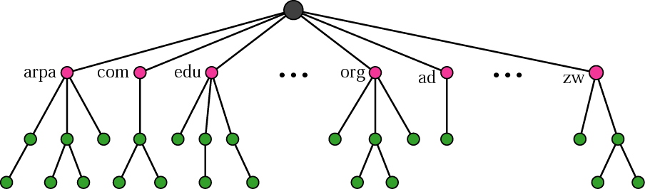
Domain name space
Names are defined in an inverted-tree structure with the root at the top.
Can have 128 levels: level 0 (root) to level 127.
Label:
Each node in the tree has a level
Maximum of 63 characters.
Root label is a null string (empty string).
Children of a node have different labels.

Slide 17
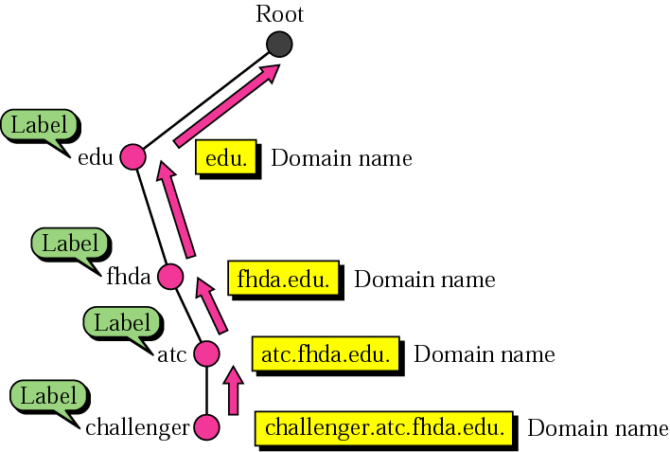
Domain names and labels
Full domain name is a sequence of labels separated by dots.
Domain names are always read from the node up to the root. Last label is the label of root (null). So, full domain name always ends in a null label [means dot].

Slide 18
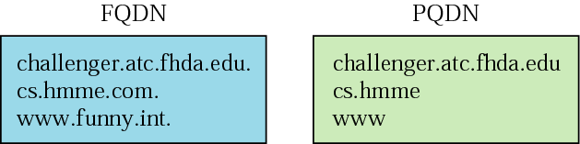
FQDN and PQDN
Fully Qualified Domain Name (FQDN) or Absolute Domain Name
Label is terminated by a null string.
Contains the full name of a host.
Partially Qualified Domain Name (PQDN) or Relative Domain Name
Not terminated by a null string.
Used when the name to be resolved belongs to the same site as the client.
Resolver supplies the missing part called a suffix.

Slide 19
Fully Qualified Domain Name
Sometimes also referred to as an absolute domain name
It is a domain name that specifies its exact location in the tree hierarchy of the Domain Name System.
It specifies all domain levels, including the top-level domain and the root zone.

Slide 20
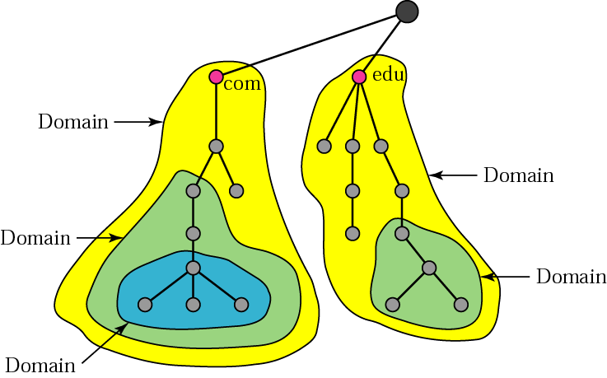
Domains
Domain:
Subtree of the domain name space.
Name of the domain is the domain name of the node at the top of the subtree.
A domain can be divided into subdomains.

Slide 21
DNS and client-server computing
DNS names are managed by a hierarchy of DNS servers
Root server at top of tree knows about next level servers.
Next level servers, in turn, know about lower level servers
Some Jargon
Each DNS server is the authoritative server for the names it manages
What a server is responsible for or has authority over is called a zone. A domain can span multiple servers.
Primary server is also called authoritative server
Second server has a copy

Slide 22
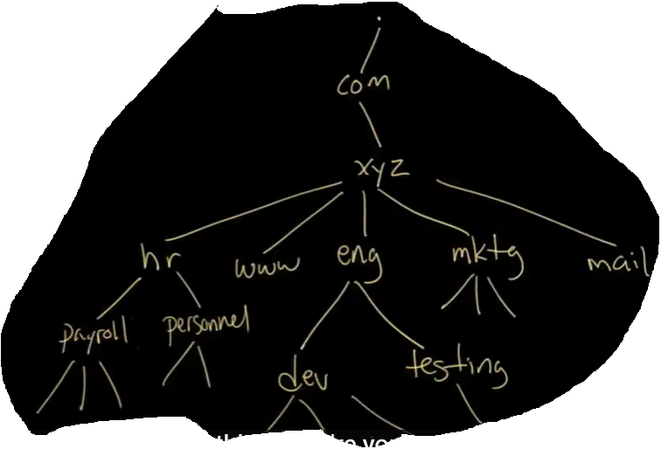
What are DNS ZONES | DNS Zones explained | DNS Zones and Delegation | Tutorial on DNS Zones https://www.youtube.com/watch?v=JIwi6ii-rzI
Explained
Quiz: Create your own structure

Slide 23
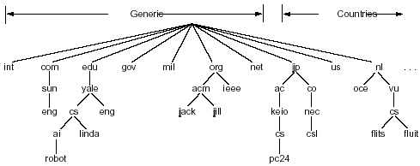
Root Name Servers: A root name server is a name server for the root zone of the Domain Name System (DNS) of the Internet. It directly answers requests for records in the root zone and answers other requests by returning a list of the authoritative name servers for the appropriate top-level domain (TLD)
Root Server

Slide 24
Choosing DNS server architecture
Small organizations can use a single server
Easy to administer
Inexpensive
Large organizations often use multiple servers
Reliability through redundancy
Improved response time through load-sharing
Delegation of naming authority
Locality of reference applies - users will most often look up names of computers within same organization
All DNS servers are linked together to form a unified system. Each server knows how to reach a root server and how to reach servers that are authorities for names further down the hierarchy.

Slide 25
Name Resolution
host surf.eurecom.fr wants IP address of gaia.cs.umass.edu
1. contacts its local DNS server, dns.eurecom.fr
2. dns.eurecom.fr contacts root name server, if necessary
3. root name server eventually contacts authoritative name server, dns.cs.umass.edu, if necessary
This is called “Recursive Resolution”
root name server
2
6
7
3
local name server
dns.eurecom.fr
intermediate name server
dns.umass.edu
4
5
1
8
authoritative name server
dns.cs.umass.edu
requesting host
surf.eurecom.fr
gaia.cs.umass.edu

Slide 26
Types of Queries
root name server
recursive query:
puts burden of name resolution on contacted name server
heavy load?
iterated query:
contacted server replies with name of server to contact
“I don’t know this name, but ask the following server(s)”
Gives more control to client
2
iterated query
3
4
7
local name server
dns.eurecom.fr
5
6
1
8
authoritative name server
dns.cs.umass.edu
requesting host
surf.eurecom.fr
gaia.cs.umass.edu

Slide 27
Non-Recursive Query
A non-recursive query is a query in which the DNS Resolver already knows the answer.
It either immediately returns a DNS record because it already stores it in local cache, or queries a DNS Name Server which is authoritative for the record, meaning it definitely holds the correct IP for that hostname.
In both cases, there is no need for additional rounds of queries (like in recursive or iterative queries). Rather, a response is immediately returned to the client.
https://ns1.com/resources/dns-types-records-servers-and-queries

Slide 28
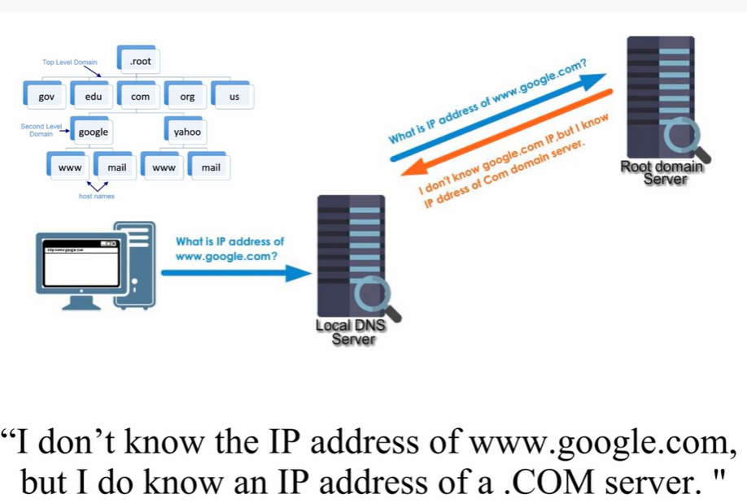
Searching for www.google.com

Slide 29
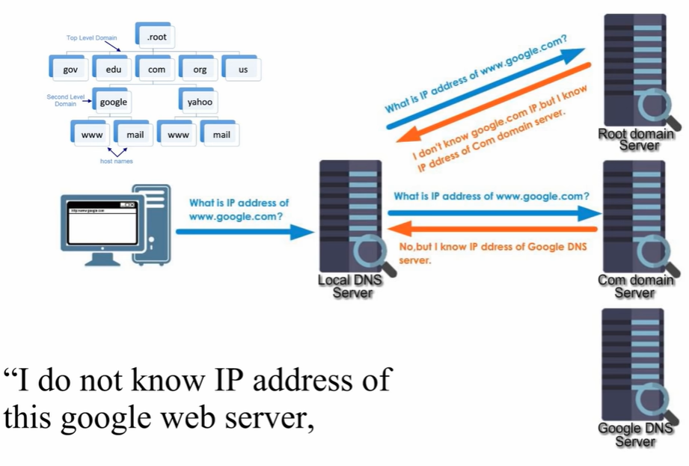
Searching for www.google.com

Slide 30
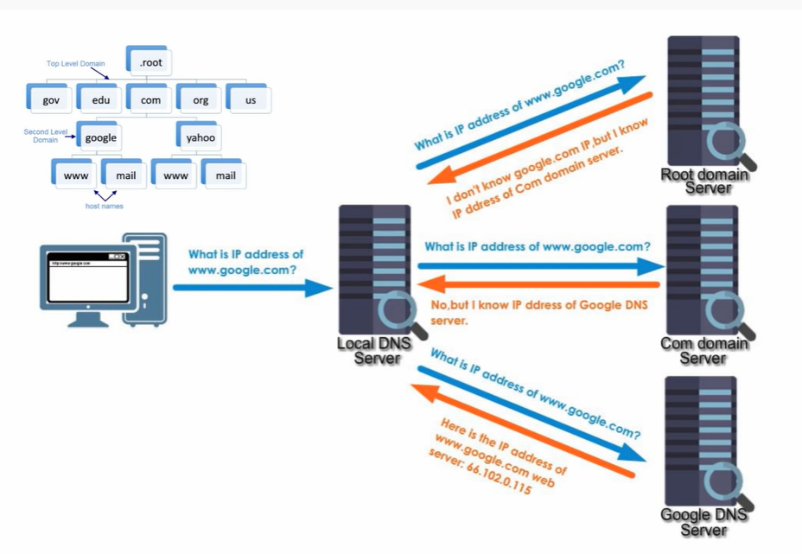
Searching for www.google.com

Slide 31
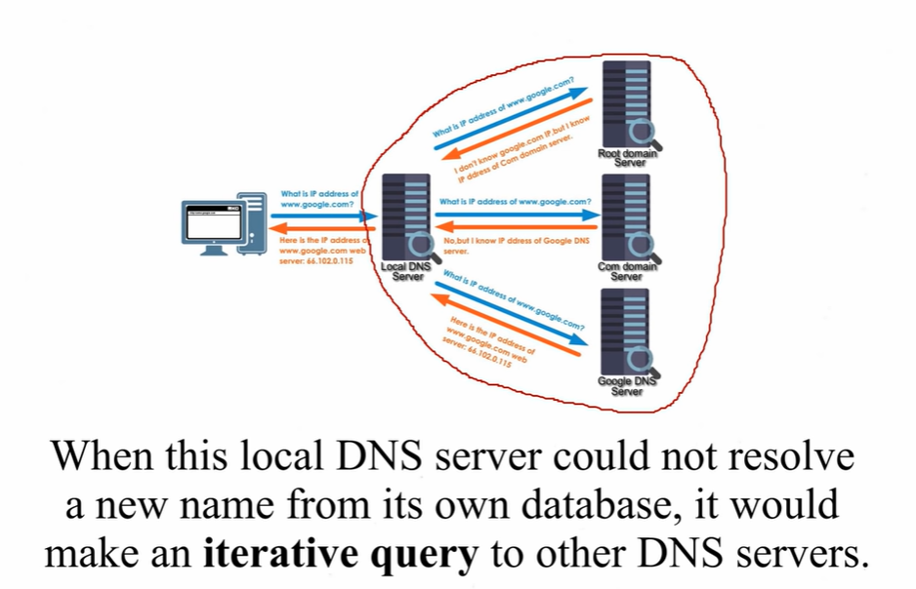
Iterative Query

Slide 32
DNS recursive query vs. Iterative query
https://www.youtube.com/watch?v=PS0UppB3-fg
How to check your current DNS
https://www.youtube.com/watch?v=ghWBAGZxd2s

Slide 33
SAMPLE FORWARD LOOKUP FILE
Information about the lookup itself
Mail exchange record
Records that specify the name and IP
Aliases that allow different names to associate to a single fully qualified domain name: One physical server with multiple services.

Slide 34
DNS Types: 10 Top DNS Record Types
DNS servers create a DNS record to provide important information about a domain or hostname, particularly its current IP address. The most common DNS record types are:
Address Mapping record (A Record)—also known as a DNS host record, stores a hostname and its corresponding IPv4 address.
IP Version 6 Address record (AAAA Record)—stores a hostname and its corresponding IPv6 address.
Canonical Name record (CNAME Record)—can be used to alias a hostname to another hostname. When a DNS client requests a record that contains a CNAME, which points to another hostname, the DNS resolution process is repeated with the new hostname.
Mail exchanger record (MX Record)—specifies an SMTP email server for the domain, used to route outgoing emails to an email server. Is an extremely important record that allows the third parties to be able to find the local mail servers.
Example MX Record:
5. Name Server records (NS Record)—specifies that a DNS Zone, such as “example.com” is delegated to a specific Authoritative Name Server, and provides the address of the name server.

Slide 35
DNS Types: 10 Top DNS Record Types
Reverse-lookup Pointer records (PTR Record)—allows a DNS resolver to provide an IP address and receive a hostname (reverse DNS lookup).
Certificate record (CERT Record)—stores encryption certificates—PKIX, SPKI, PGP, and so on.
Service Location (SRV Record)—Finding specific service: a service location record, like MX but for other communication protocols.
Example of SRV:
Associate a particular service (_ldap._tcp.domain.com with a particular device (s1.domain.com)
https://ns1.com/resources/dns-types-records-servers-and-queries

Slide 36
DNS Types: 10 Top DNS Record Types
Text Record (TXT Record)—typically carries machine-readable data such as opportunistic encryption, sender policy framework, DKIM, DMARC, etc.
Start of Authority (SOA Record)—this record appears at the beginning of a DNS zone file, and indicates the Authoritative Name Server for the current DNS zone, contact details for the domain administrator, domain serial number, and information on how frequently DNS information for this zone should be refreshed.
Sender Policy Framework (SPF)→ allows email senders to define which IP addresses
are allowed to send mail for a particular domain.
Domain Keys Identified Mail (DKIM )→ provides an encryption key and digital signature
that verifies that an email message was not forged or altered.
Domain-Based Message Authentication Reporting and Conformance (DMARC,)
is an added authentication method that uses both SPF and DKIM to verify whether or not
an email was actually sent by the owner of the “Friendly-From” domain that the user sees.
https://ns1.com/resources/dns-types-records-servers-and-queries

Slide 37
References
https://www.slideserve.com/zavad/module-2-2-domain-name-system-powerpoint-ppt-presentation
https://computers.tutsplus.com/tutorials/how-to-change-your-dns-for-safer-faster-browsing--mac-61232

Slide 38
The End

